Slide 1
Cochlear implants and older adults
Frank R. Lin, M.D. Ph.D.
Associate Professor of Otolaryngology, Geriatric Medicine,
Mental Health, & Epidemiology
Johns Hopkins University
Baltimore, Maryland

Slide 2
Key questions
Do older adults benefit from CI given the cognitive processing and neural plasticity needed for adaptation to the CI?
On the horizon: Can we optimize outcomes with pharmacologic therapies?

Slide 3
Do older adults benefit from a CI?

Slide 4
Cochlear implantation in older adults
Retrospective review of an established clinical database for CI speech outcomes at the Johns Hopkins Listening Center
Reviewed data from all CI recipients ≥ 60 years who received a first CI between 1999-2011 (n = 445)
Identified participants who had HINT in quiet scores performed under identical conditions at baseline and 1 year post-CI (n = 83)
Other participants had different speech tests performed (e.g. CNC), non-identical presentation at pre-CI and 1 year post-CI, missing 1 year data, etc.
Medicine, 2012, 91, 229-241
Notes:
Add in brain aging, kahneman, and voxel based image
Then overview with epi results
Then box with RCT
Myth 2 HL can be succesfully treated by any audiologist??
Then slide
Then case presentation

Slide 5
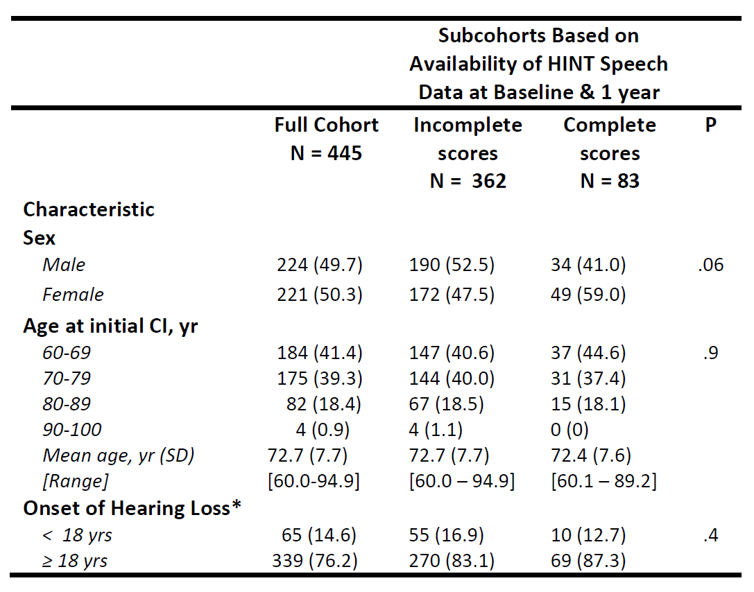
CI in Adults ≥ 60 years at Johns Hopkins from 1999-2011
Medicine, 2012, 91, 229-241

Slide 6
HINT Speech Scores from Pre to 1 Year Post -CI
In our retrospective case series, CI in older adults was consistently associated with gains in speech understanding
Medicine, 2012, 91, 229-241

Slide 7
Association of Age at Implantation with Speech Understanding Outcomes
Medicine, 2012, 91, 229-241

Slide 8
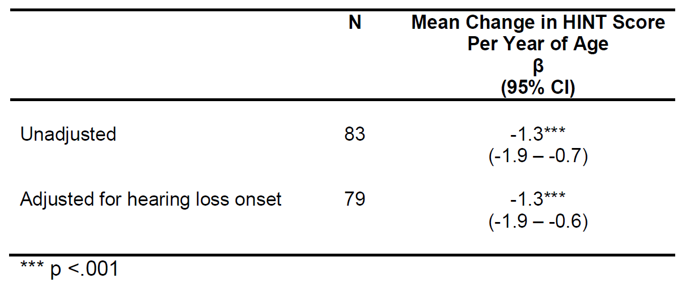
Association of Age at Implantation with Speech Understanding Outcomes
On average, a 60 year-old adult undergoing CI had a 75 point improvement in HINT scores whereas an 80 year-old adult had a 50 point improvement.
Medicine, 2012, 91, 229-241

Slide 9
Association of Pre-CI Speech Understanding with Post-CI Speech Understanding
Mean Post-CI
Score: 77.3%
Mean Post-CI Score: 89.7%
Medicine, 2012, 91, 229-241

Slide 10
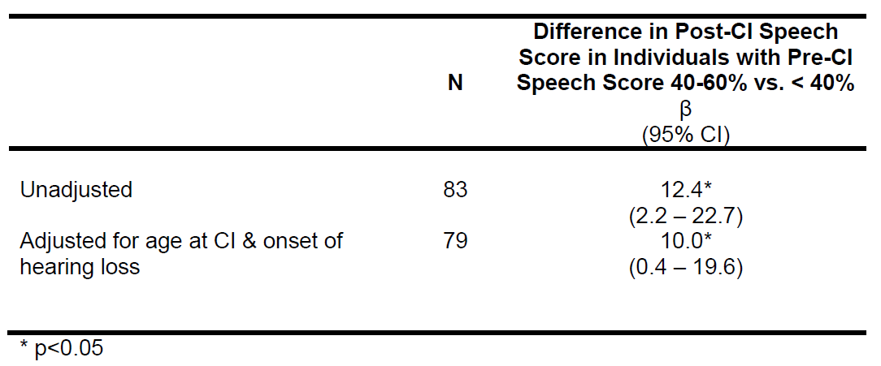
Association of Pre-CI Speech Understanding with Post-CI Speech Understanding
After adjusting for age at CI and onset of hearing loss, individuals with higher baseline speech scores (40-60%) had HINT scores at 1 year that were 10 points higher than scores in individuals with lower baseline speech scores (<40%).
Medicine, 2012, 91, 229-241

Slide 11
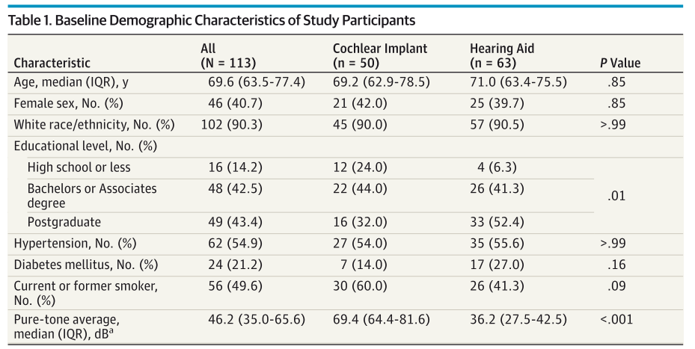
Studying Multiple outcomes following Aural Rehabilitative Treatment (SMART) Study
JAMA-Oto, 2016, 142(7):652-7

Slide 12
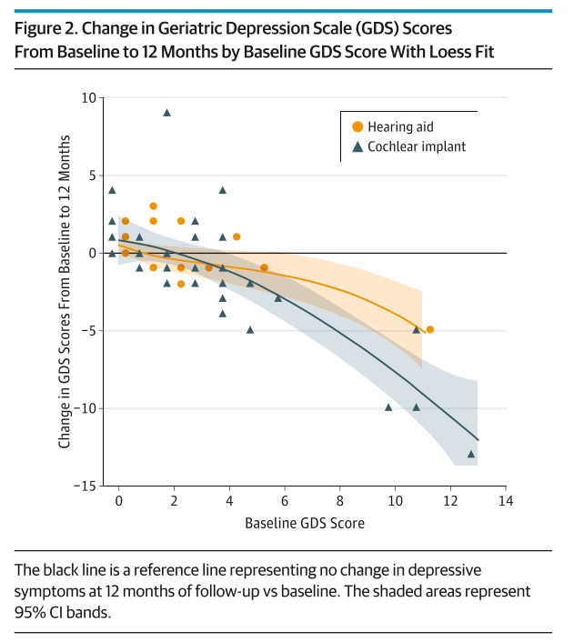
SMART Study – Change in Depression Symptoms
JAMA-Oto, 2016, 142(7):652-7

Slide 13
SMART – Change in Loneliness
Laryngoscope, 2017, In press

Slide 14
SMART Study – Change in Quality of life
Laryngoscope, 2016, 126, 2110-5

Slide 15
Can we optimize outcomes with pharmacologic therapies?

Slide 16
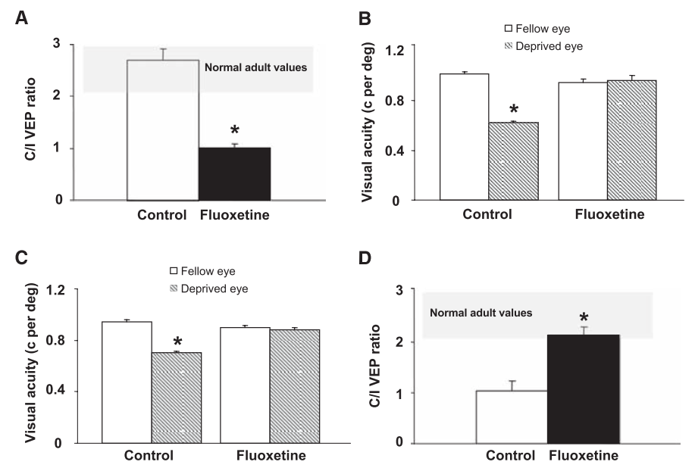
Brain plasticity with fluoxetine
Maya Betencourt et al
Adult amblyopic rats
Reactivation of visual cortical plasticity after fluoxetine treatment
Science, 2008, 320, 385-388
Notes:
Add in brain aging, kahneman, and voxel based image
Then overview with epi results
Then box with RCT
Myth 2 HL can be succesfully treated by any audiologist??
Then slide
Then case presentation

Slide 17
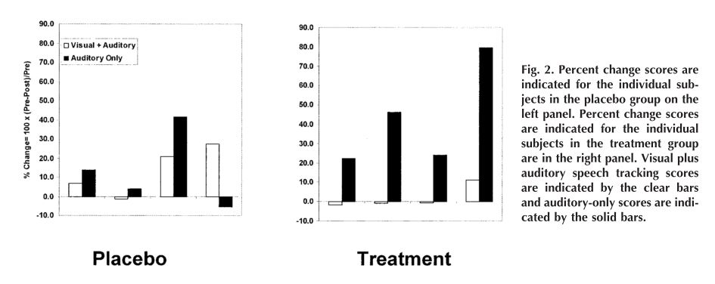
d-amphetamine
Tobey et al, 2005; UT Dallas
Participants: 8 CI recipients aged 44-74.
Randomly assigned to a placebo or treatment group.
Each week for 8 weeks:
Treatment group: 10mg d-amphetamine + Auditory rehabilitation program
Placebo: Placebo + Auditory rehabilitation program
Ear & Hearing, 2005, 26, 45S-56S
Notes:
Add in brain aging, kahneman, and voxel based image
Then overview with epi results
Then box with RCT
Myth 2 HL can be succesfully treated by any audiologist??
Then slide
Then case presentation

