Slide 1
DEAFNESS funding –LOOKING AHEAD
Kim von Lanthen, November 2019
45 mins

Slide 2
projected prevalence of DeaFNESS
http://www.nzma.org.nz/journal/read-the-journal/all-issues/2010-2019/2015/vol-128-no-1419-7-august-2015/6608

Slide 3
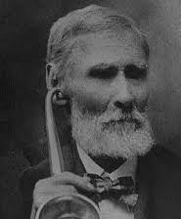
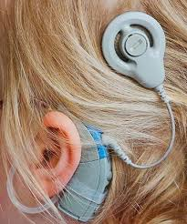
SERVICE TRENDS

Slide 4
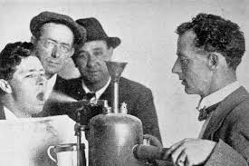
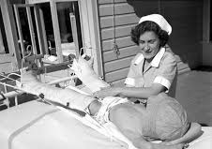
WILL INCURABLE DEAFNESS BECOME A THING OF THE PAST?
Influenza epidemic peak of 1,200 deaths per week
Worst year for polio fatalities 1925, 173 died
https://www.nzma.org.nz/journal/read-the-journal/all-issues/2010-2019/2018/vol-131-no-148714-december-2018/7769
https://www.nzherald.co.nz/nz/news/article.cfm?c_id=1&objectid=12034351

Slide 5
THE FUTURE OF DEAFNESS

Slide 6
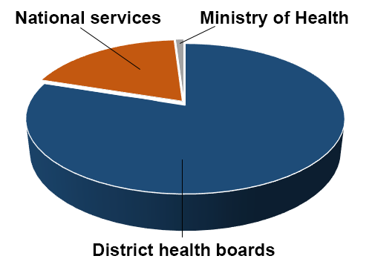
VOTE HEALTH: $17.1 BILLION

Slide 7
Funding trends

Slide 8
GROSS Additional SPENDING
Year ending 30 June $millions | 2019 Forecast | 2020 Forecast | 2021 Forecast | 2022 Forecast | 2023 Forecast | 5-year Total
Health | 166 | 1,037 | 1,114 | 1,149 | 1,200 | 4,666
Social security and welfare | 45 | 433 | 609 | 574 | 596 | 2,257
Education | (190) | 158 | 306 | 366 | 510 | 1,150
Law and order | 172 | 223 | 177 | 181 | 189 | 942
Primary services | 354 | 308 | 109 | 68 | 64 | 903
Core government services | 5 | 199 | 238 | 206 | 212 | 860
Economic and industrial services | 191 | 278 | 78 | 69 | 71 | 687
Defence | 21 | 96 | 132 | 135 | 124 | 508
Heritage, culture and recreation | - | 140 | 135 | 119 | 99 | 493
Housing and community development | - | 106 | 102 | 109 | 116 | 433
Environmental protection | - | 21 | 32 | 27 | 27 | 107
Transport and communications | 9 | 22 | 14 | 9 | 5 | 59
Unallocated contingencies | - | 428 | 569 | 650 | 585 | 2,232
 | 773 | 3,449 | 3,615 | 3,702 | 3,863 | 15,402
https://treasury.govt.nz/publications/efu/budget-economic-and-fiscal-update-2019-html#section-5

Slide 9
WILL PLANNED FUNDING INCREASES HELP?

Slide 10
10 year trends
Increasing prevalence driven by epidemiology and the change in the age structure of the population
Technology to eradicate deafness, in the time honoured tradition of medical advancement
Continuing increase in public health funding doesn’t generally translate into increased services

Slide 11
FUNDING OPTIONS
National Disability Support Services
Itemised with dedicated staff
Enables two trusts approach
But, will deafness remain as a disability?
Other National Services
Higher profile
District Health Boards
Automatic funding increases
Integrated with other services
Greater regional distribution of services

Slide 12
10 YEAR thrust
Focus: the end of deafness as a disability
Development: awareness of how the solutions work, growing demand for them
Defence: better regional distribution of trust services, with increased DHB support

